Slide 1
Term Document Frequency: Robert Frost and Walt Whitman
Cosc 594
R.J. Lusk

Slide 2
This Project’s Impact on Operational Data
Key Issues with Operational Data
Missing data.
Wrong data.
Context- Potential key issue of this project

Slide 3
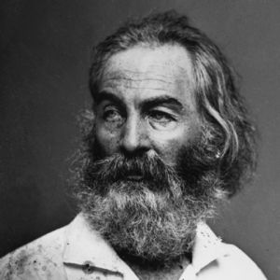
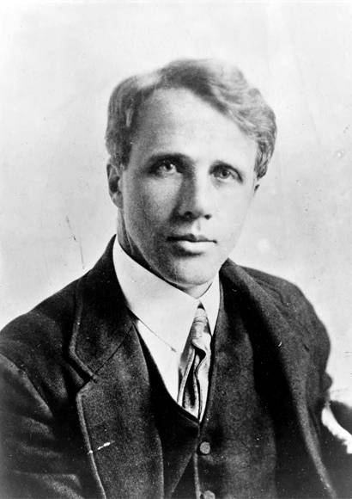
Brief Background
Walt Whitman
Leaves of Grass (1870)
Robert Frost
A Boy’s Will (1915)
North of Boston (1914)

Slide 4
Brief Background
Some Issues of Context
Time period - affects both themes and word usage.
Late 19th , early 20th Century American English writers
pronounced emphasis on nature
The Northeastern United States.
Author’s style and vernacular. Variation for a single author.
Multiple Editions of work
Leaves of Grass had 9 different editions (1st in 1855, 9th in 1892).

Slide 5
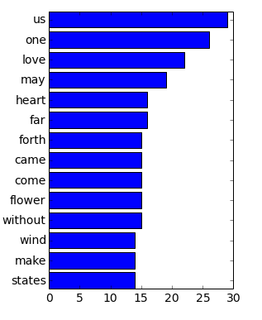
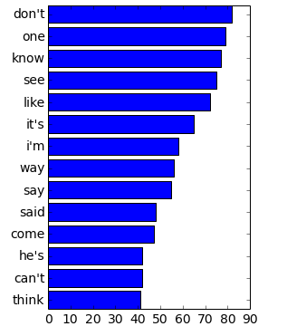
Results – Robert Frost Books
A Boy’s Will
North of Boston

Slide 6
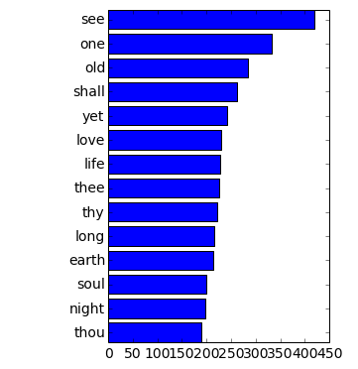
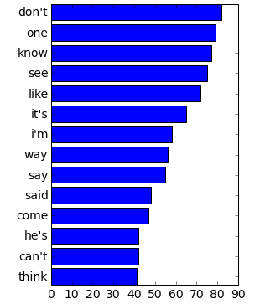
Results- Whitman and Frost
Leaves of Grass (Whitman)
North of Boston (Frost)

Slide 7
Conclusions and Future Work
North of Boston and prevalence of commonplace words.
Overrepresentation of Terms of Use words on smaller documents.
Necessity for a “base” corpus. A comparative document for a given genre i.e. The Penn Treebank.
Difficulty to even establish base for a single author.
More advanced forms of text analysis: n-grams.

